Slide 1
This Way>>>>>>
flexpay.uk.com

Slide 2
Oriel’s innovative FlexEd managed payment plan solution, helping students since 2012 is now being expanded under the FlexPay brand!

Slide 4
Features and benefits
You can pay monthly for your course at very low cost with no interest or credit checks
You pay a small admin fee to FlexPay who manage your payment plan for the College or Uni. But sometimes they pay for this so it may be free!

Slide 5
Features and benefits
You can apply for FlexPay online via your College or Uni website or either directly at flexpay.uk.com. Just complete your personal details pick your course and submit!
Once the College or Uni approve your application you set up your payment plan. It takes less than 10 minutes!

Slide 6
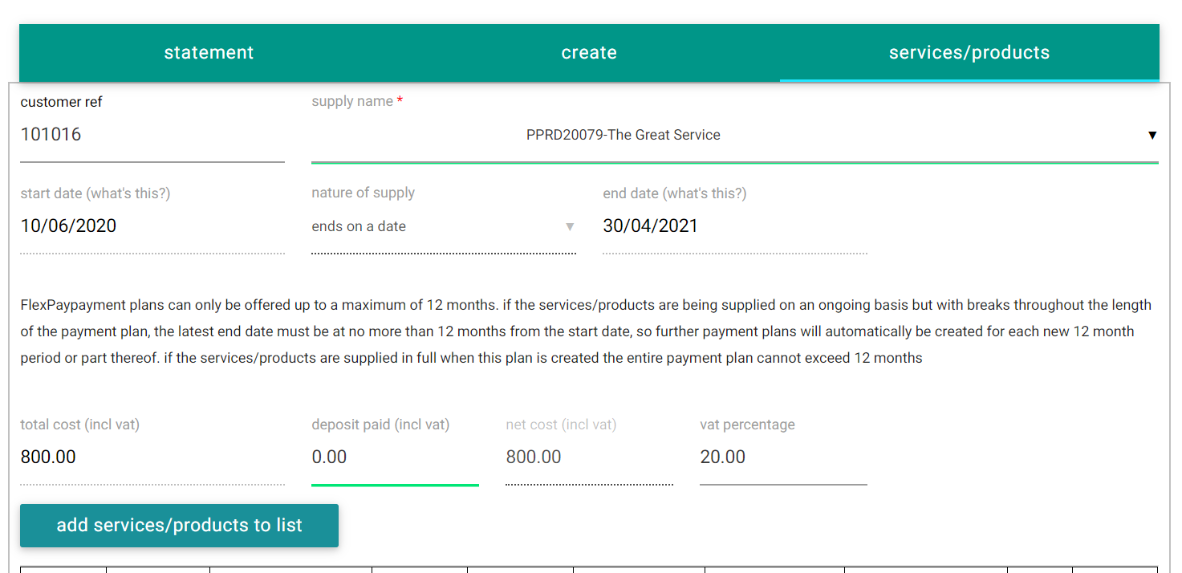
Student Online Application for Course

Slide 7
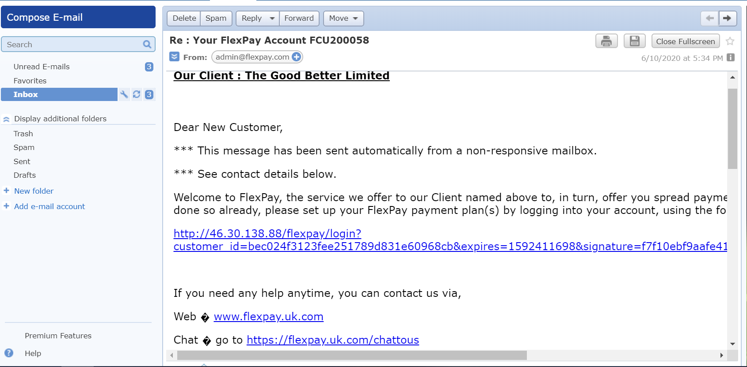
Student Welcome Email

Slide 8
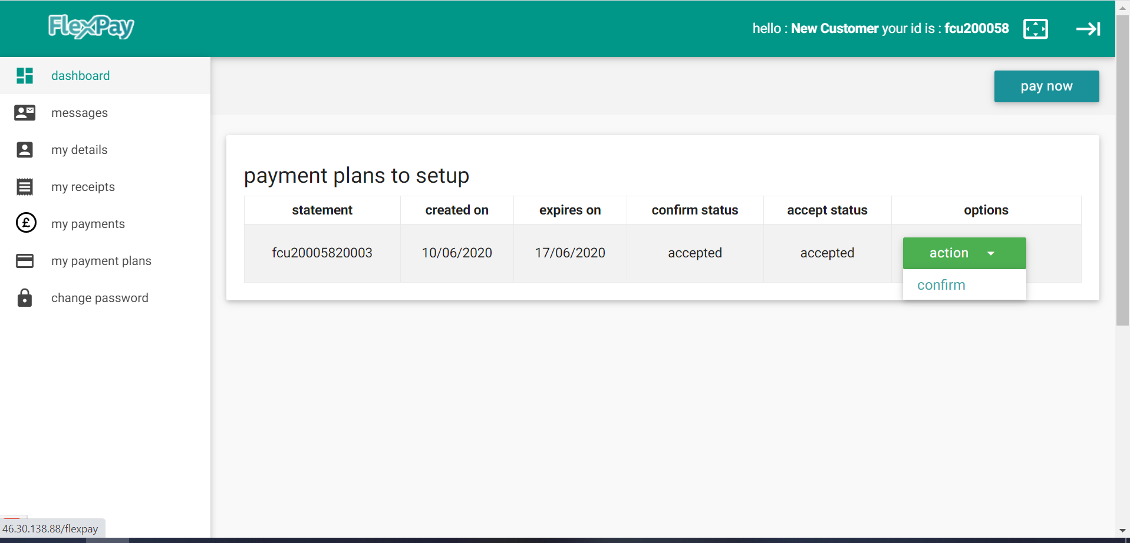
Student Dashboard

Slide 9
Features and benefits
You select the period you want to pay over and you can see how much you’ll pay for each period you could select.
You can’t pay over longer than 12 months but if your course is longer than this, you set up a plan for each academic year when you start the course. Easy!

Slide 10
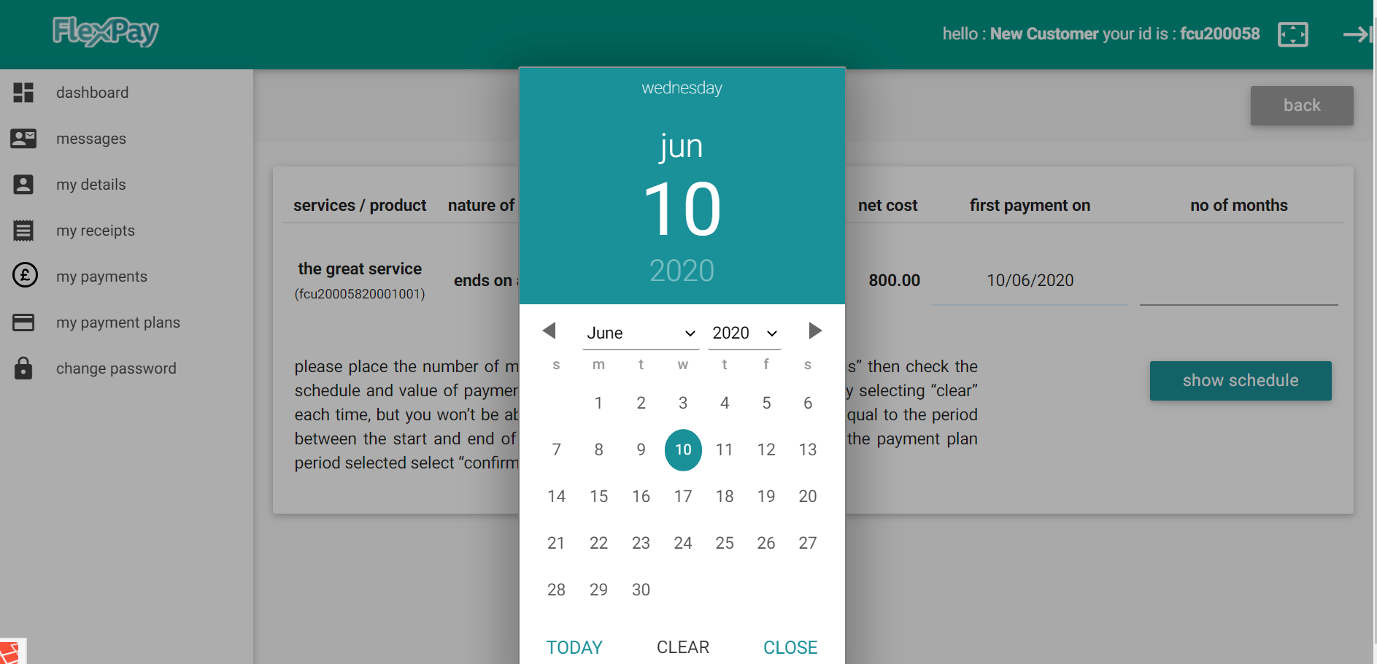
Setting up Payment Plans are Easy

Slide 11
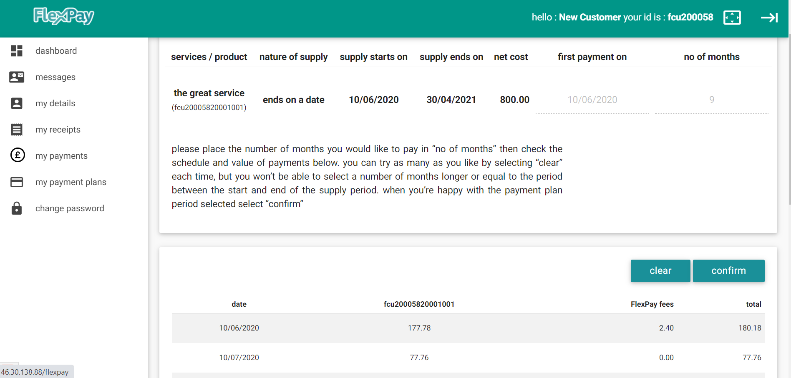
Student can Try Different Payment Plan Lengths

Slide 12
Features and benefits
FlexPay collect recurring payments from your debit or credit card each month for your plan and remind you if any payments don’t go through..
If you don’t keep your plan up to date eventually there are late payment fees but we tell you all about this before you set up your plan. If you have genuine problems we’ll work with you to find the best way forward.

Slide 13
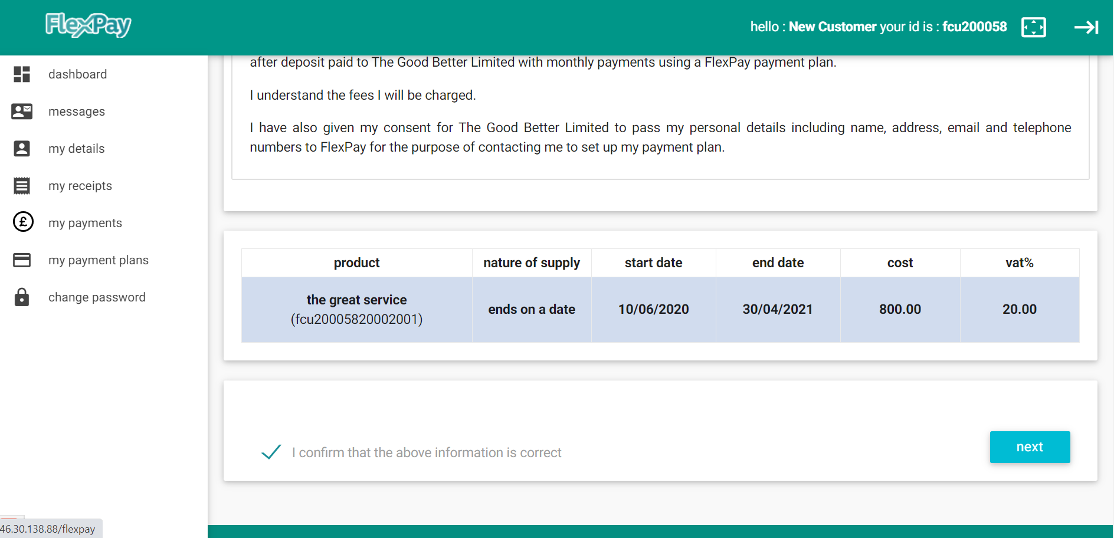
Online Statement and Consents for Students

Slide 14
Features and benefits
And once you’re set-up you can login to your dashboard, message us or the College or Uni, check your payment plan and balances make one-off payments and apply for new FlexPay payment plans, not just with the College or Uni with loads of other Suppliers using FlexPay.
If you want to buy something and can’t find it on FlexPay tell us and we’ll try and find a Supplier who will agree a FlexPay payment plan for you

Slide 15
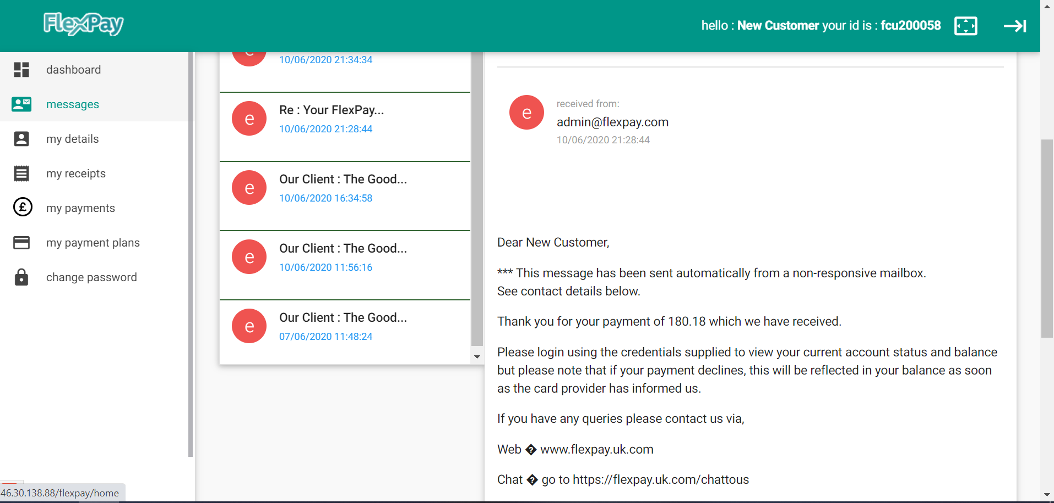
Student Dashboard.
Full Messaging

Slide 16
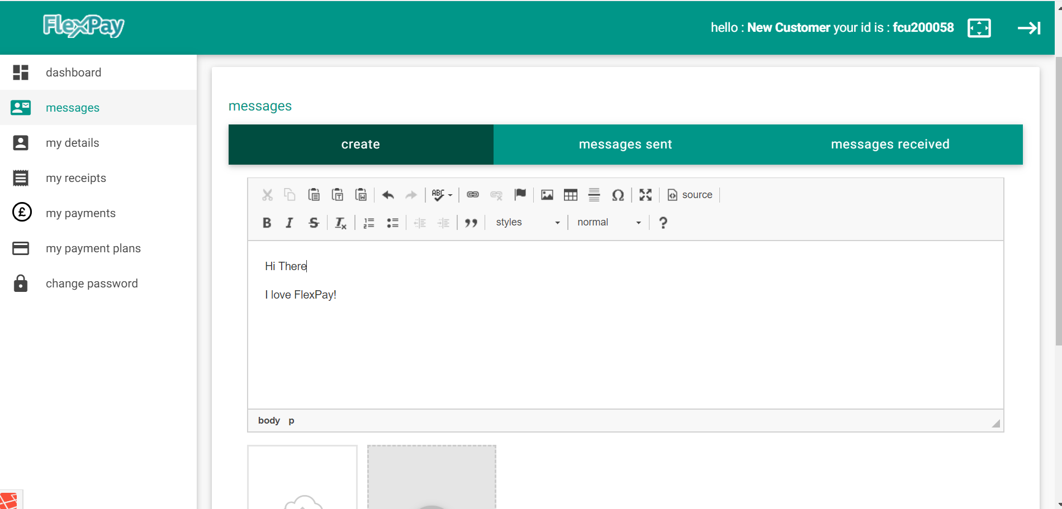
Tell Us About It!

Slide 17
This Way>>>>>>
flexpay.uk.com

